Slide 1
UNIVERSITY KUALA LUMPUR
MALAYSIAN INSTITUTE OF INFORMATION TECHNOLOGY
WEB BASED AUTHORING (IMB20803)
GROUP : L01
PROPOSAL PLAN (MINI PROJECT 1)
TITLE:
AWARENESS CAMPAIGN IN PREVENTION AGAINST COVID-19
GROUP MEMBER :
PREPARED FOR:
MADAM NORSHAHARIZAN PUTEH
NO | NAME | ID NUMBER
1 | NUR AMIRAH BINTI NOOR HASHIM | 52216220097
2 | WAN NOORFAZIERA BINTI WAN NOORDIN | 52216119251

Slide 2
Proposal Plan
Introduction :
Malaysia is currently experiencing a public health emergency as a result of the COVID-19 pandemic. The Covid-19 pandemic in Malaysia is part of the ongoing worldwide pandemic of coronavirus disease 2019 (Covid-19) caused by severe acute respiratory syndrome coronavirus 2 (SARS-CoV-2).

Slide 3
Site tittle : Prevention Better Than Cure
Problem statement :
Some people lack of information about Covid-19
Community does not take serious about Covid-19
There are still many who don’t want to take the vaccine as a precaution
Rational or focus :
The Covid-19 virus is unique among community nowadays. Covid-19 since it has high transmissibility, uncontrollable fatal deaths in high-risk age groups, and has ability to cause huge social disharmony and economic loss. The present scenario of increasing Covid-19 patients and number of deaths per day shows that the global population seems to be susceptible to this virus.

Slide 4
Objectives
General objective :
• To assess the knowledge and attitude on Covid-19 among community in Malaysia
Specific objective :
• To identify the socio-demographic data of the community people
• To assess the knowledge about Covid-19.
• To assess the prevention measures followed by the people.
Target audience :
Age group between 21-49 years including both male and female will be target population.

Slide 5
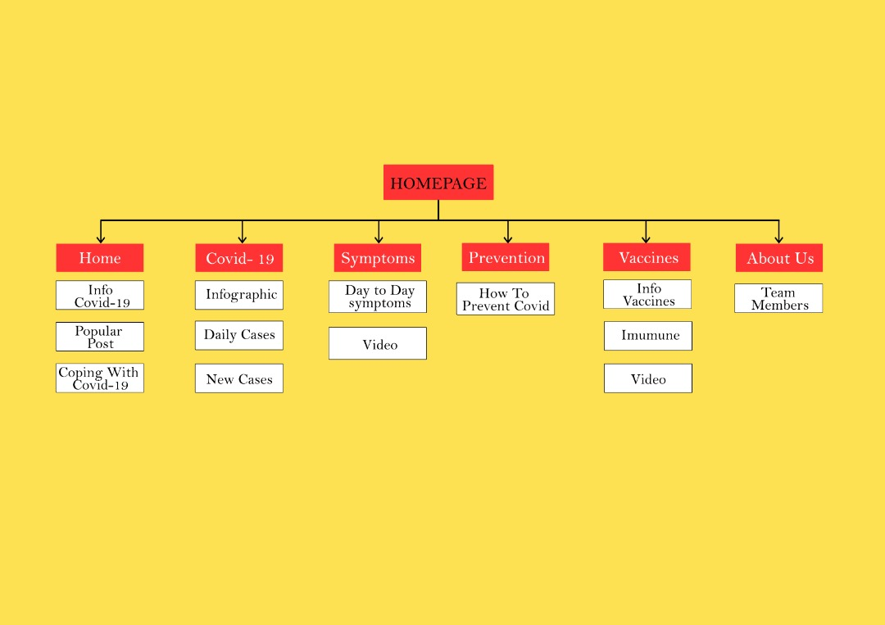

Slide 7
Thank you!

